Slide 1
Employee Data Analysis using Excel
STUDENT NAME: E. CATHERINE
REGISTER NO: 312215810
DEPARTMENT: B.COM (ACCOUNTING AND FINANCE)
COLLEGE: SHRI SHANKARLAL SUNDARBAI SHASUN JAIN COLLEGE FOR WOMEN

Slide 2
PROJECT TITLE
Employee Performance Analysis using Excel

Slide 3


AGENDA
Problem Statement
Project Overview
End Users
Our Solution and Proposition
Dataset Description
Modelling Approach
Results and Discussion
Conclusion
3/21/2024 Annual Review

Slide 4

PROBLEM STATEMENT
To focus on the growth of the organization we must analysis the performance of the employees
To analysis the personal performance of the employee so that they can be given appraisal and increment
The organization will be able to provide motivation and appreciation based on the employee performance

Slide 5
.
PROJECT OVERVIEW
This project aims to create a ANALYSIS OF THE EMPLOYEE working in a organization .It will analyze the various features in the EMPLOYEE DATA SET like Employee ID, First Name, Last Name, Business Unit, Performance level, Current Employee Rating based on the analysis we will be able to identify the best and poor performing candidate and will be provided further motivation and appreciation and also helps for the overall growth of the organisation.

Slide 6

WHO ARE THE END USERS?
Employer
Employee
Manager
Organisation
IT Sectors
Industries
This Photo by Unknown Author is licensed under CC BY-NC

Slide 7
OUR SOLUTION AND ITS VALUE PROPOSITION
DATA ANALYSIS-Analysis and Collection of the data for the execution of the results
CONDITIONAL FORMATTING-To identify and edit the missing values
SORT AND FILTER-To remove the missing values
FORMULA-To create a performance level column using the formulas and current employees rating
PIVOT TABLE-To create the performance analysis and create a table based on the male or female employees
GRAPH/CHART-To create the final result of the analysis of the employee performance

Slide 8
Dataset Description
Employee data set taken from the Kaggle
In dataset, out of 26 data I took only 9 features out of it.
THE SELECTED 10 FEATURES ARE LISTED BELOW
EMPLOYEE ID
FIRST NAME
LAST NAME
BUSINESS UNIT
EMPLOYEE TYPE
EMPLOYEE STATUS
EMPLOYEE CLASSIFICATION TYPE
GENDER CODE
PERFORMANCE SCORE
CURRENT EMPLOYEE RATING

Slide 9

THE "WOW" IN OUR SOLUTION Performance level =IFS(Z8>=5,”VERY HIGH”,Z8>=4,”HIGH”,Z8>=3,”MED”,”TRUE”,”LOW”)
3/21/2024 Annual Review
9

Slide 10
MODELLING
DATA COLLECTION
The data has been collected from the EDUNET DASHBOARD.
FEATURE COLLECTION
The listed 10 features were taken for the analysis of the data.
DATA CLEANING
Identify the missing values.
Filtering of those missing values.
CALCULATION OF PERFORMANCE LEVEL
By considering the current employee rating I found the performance level using the IFS FORMULA.
SUMMARY OF PIVOT LEVEL
Segregating of certain features to rows, columns, headings and so on.
VISUALIZATION
Once completed with pivot table, created the graph for the precise visualization.

Slide 11
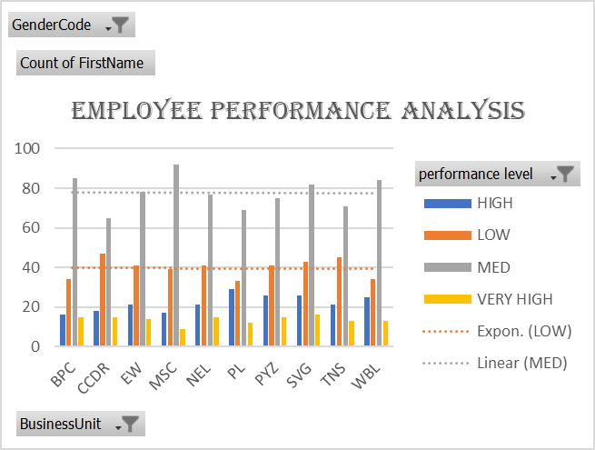
RESULTS
11

Slide 12
conclusion
This project aims to create a ANALYSIS OF THE EMPLOYEE working in a organization .It will analyze the various features in the EMPLOYEE DATA SET like Employee ID, First Name, Last Name, Business Unit, Performance level, Current Employee Rating based on the analysis we will be able to identify the best and poor performing candidate and will be provided further motivation and appreciation and also helps for the overall growth of the organisation.

